Slide 1
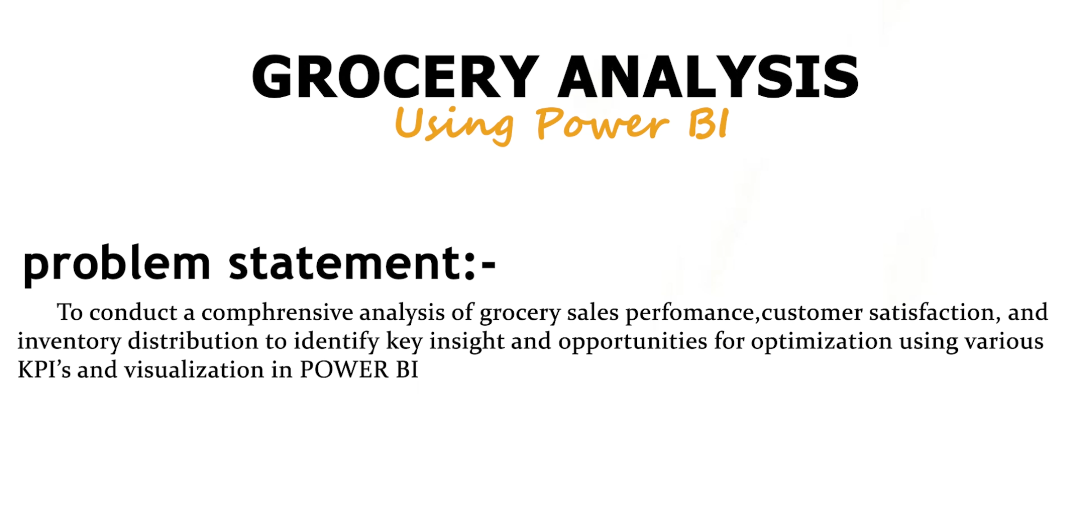

Slide 2

KPI’s Requirements :
Total Sales: The overall revenue generated from all items sold.
Average Sales: The average revenue per sale.
Number of Items: The total count of different items sold.
Average Rating: The average customer rating for items sold.

Slide 3
Steps in Project:
Requirements Gatherings
Data Walkthrough
Data Connection
Data Cleaning / Quality Check
Data Modeling
Data Preprocessing
DAX Calculations
Dashboard Lay outing
Charts Development and Formatting
Dashboard / Report Development
Insight Generation

Slide 4
Business requirements
1) Total Sales by Fat Content:
objective: Analyze the impact of fat content on total sales.
Additional KPI Metrics: Assess how other KPI’s(Average Sales, Number of Items, Average rating) vary with fat content.
Chart Type: Donut Chart
2) Total Sales by Item Type:
Objective: Identify the performance different items type in total sales.
Additional KPI Metrics: Assess how other KPI’s(Average Sales, Number of Items, Average Rating) vary with fat content
Chart Type: Bar Chart
3) Fat Content by Outlet for Total Sales:
Objective: Compare total sales across different outlets segmented by fat content
Additional KPI Metrics: Assess how other KPI’s(Average Sales, Number of Items, Average Rating) vary with fat content
Chart Type: Column Chart

Slide 5
Business requirements
4) Total Sales by Outlet Establishment:
Objective: Evaluate how the age or type of outlet establishment influence total sales.
Chart Type: Line Chart.
5) Sales by Outlet Size:
Objective: Analyze the correlation between outlet size and total sales.
Chart Type: Donut / Pie Chart
6) Sales by Outlet Location:
Objective: Assess the geographic distribution of sales across different location
Chart Type: Funnel Map.
7) All metrics by Outlet Type:
Objective: Provide a comphrensive view of all key metrics (Total Sales, Average sales, Number of Items, Average Rating)
Chart Type: Matrix Card

Slide 6
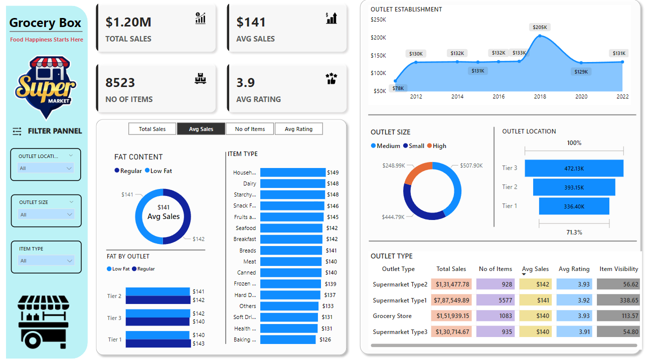
Project Outlet:

Slide 7
Conclusion:
The data analysis project on grocery sales performance, customer satisfaction, and inventory distribution provided valuable insights that could support strategic decision-making and operational improvements. Key findings include identifying high-performing products, understanding customer satisfaction drivers, and pinpointing inventory management inefficiencies. By leveraging Power BI to visualize these trends, the project revealed actionable insights, such as optimizing stock levels for popular items, addressing customer concerns to improve satisfaction, and reallocating resources to align with demand patterns. These insights equip the business to make informed decisions that enhance sales, streamline inventory management, and improve overall customer satisfaction.

